Slide 1
Software Engineering (303105254)

Slide 2

UNIT - 8
Advanced Software Engineering

Slide 3
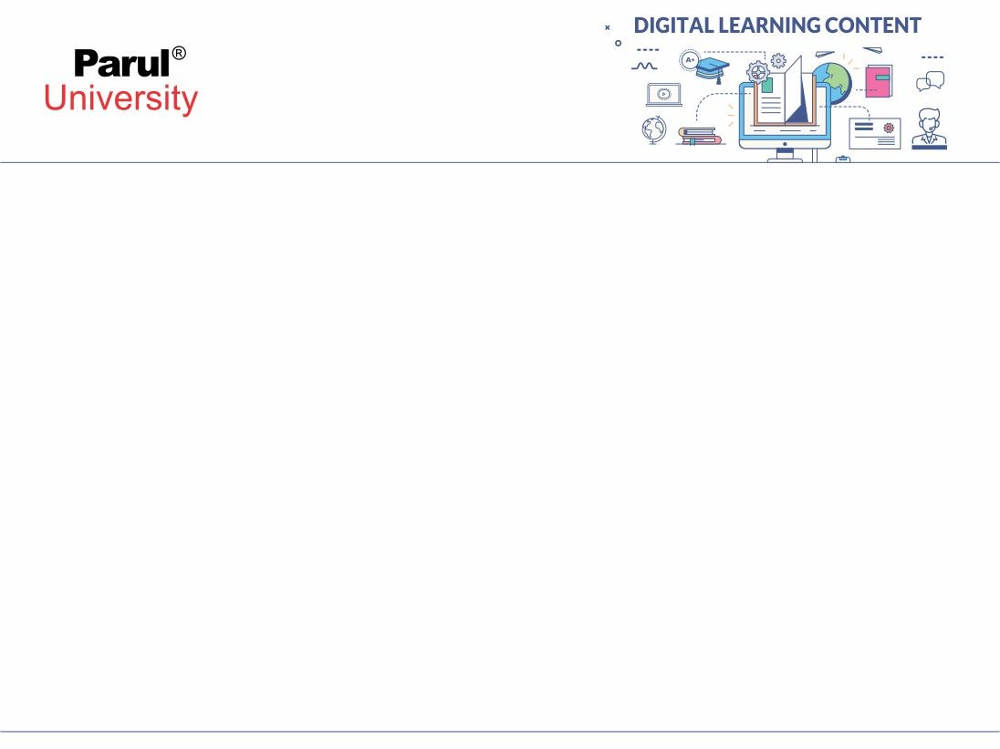
Advanced Software Engineering Topics
Software Reuse
Component Based Software Engineering
Distributed Software Engineering
Service-Oriented Software Engineering
Real-Time Software Engineering
Systems Engineering
Systems of System

Slide 4
Software Reuse
Reuse-based software engineering is an approach to development that tries to maximize the reuse of existing software.
Availability of reusable software at low cost
Demands for lower software production and maintenance costs
Faster delivery of systems
Recognized software quality
Software Reuse Levels
Application system reuse
Component reuse
Object and function reuse

Slide 5
Benefits of Software Reuse
Increased dependability
Tried and tested
More dependable than new software
Identified and Fixed design and implementation faults
Reduced process risk
Known cost of existing software
Easy to make decision for Project Rebuilt
Reduces the margin of error in project cost estimation
Highly Helpful for large software components-subsystems

Slide 6
Benefits of Software Reuse
Effective use of specialists
Reduce Rework
Better Utilization specialist's knowledge
Standards compliance
Use of standard user interfaces
Improves dependability
Reduces mistakes from user as familiar interface
Accelerated development
Image source : Google

Slide 7
Benefits of Software Reuse
Accelerated development
Launch a system to market at earliest
Speed up system production
Reduction in development and validation time

Slide 8
Threats or Challenges with Software Reuse
Lack of tool support
Not-invented-here syndrome
Creating, maintaining, and using a component library
May Increased maintenance costs
Finding, understanding, and adapting reusable components

Slide 9
Key factors during planning Software Reuse
Development schedule
Expected software lifetime
Development team's background, skills, and experience
Criticality of the software
Software's non-functional requirements
The application domain
The execution platform

Slide 10
Component Based Software Engineering (CBSE)
Components and Component Models
Component Based Software Engineering Processes
Component Formation

Slide 11
Component and Component Models
Components - Highly Useful for Achieving Reusability
Module which can be independently functions deployed or composed without modifications from the system.
Characteristics of Components
Standardized, Independent, Compos-able, Deployable, Documented
Component Models:
Based on definition of standards for component implementation, documentation, and deployment.
Implement through interfaces, usage and Deployment through Platform or Support Services

Slide 12
Component Based Software Engineering Processes
Types of Component Based Software Engineering Processes
Development for reuse
Development with reuse
Reuse supports processes related to
Component acquisition
Component management
Component certification

Slide 13
Component Formation
Component Composition / Formation:
The process of integrating components
Types of Component Composition:
Sequential composition
Hierarchical composition
Additive composition
Factors in Failure of Component Composition
Parameter Incompatibility & Operation Incompatibility
Operation incompleteness

Slide 14
Distributed Software Engineering
Distributed Systems – Presently Known as Cloud
A collection of independent computers
Appears to the user as a single coherent system
Software Engineering Practices are different for Distributed Systems
Main Focuses handling following during development:
Distributed systems issues
Client–server computing
Architectural patterns for distributed systems
Software as a service

Slide 15
Distributed systems issues
Important design issues that have to be considered
Transparency
Openness
Scalability
Security
Quality of service
Failure management
Dimensions of Scalability – Size, Distribution, Manageability
Types of attacks –Interception, Interruption, Modification, Fabrication
The quality of service reflects the system’s ability
Recovery Plans - Models of interaction and Middleware

Slide 16
Client–server computing
Distributed systems that are referred as client–server systems
To create and process that information
Depend on Various layers for computations
Have layered architectural model for client–server application
Presentation layer
Data management layer
Application processing layer
Database layer

Slide 17
Architectural patterns for distributed systems
Applicable architectural styles:
Master-slave architecture
Two-tier client–server architecture
Multitier client–server architecture
Distributed component architecture
Peer-to-peer architecture

Slide 18
Software as a service
Useful to reduce client side dependencies and need as requirement of client-server application
Examples are Oauth Service, Google Docs, Sheets, One Notes etc.
Also popular as SaaS - Software as a Service
Software is deployed on a server
The software is owned and managed
Users may pay for the software requiring to the amount of use
Important factors into consideration during development
Configurability
Multi-tenancy
Scalability

Slide 19
Service-Oriented Software Engineering
Focused on the development of software systems by composition of
Reusable services
Separation of concerns
Extends characteristics of component-based software engineering
Attention to :
Service-oriented interaction pattern
Service-oriented analysis and design

Slide 20
Service-Oriented Software Design Process
Primary Concerns are Focuses on:
Service candidate identification
Service interface design
Service implementation and deployment
Legacy system services
Service construction by composition:
Workflow design and implementation
Service testing

Slide 21
Real-Time Software Engineering
Time Critical Response and Result Required Systems (Time Constrained)
Soft Real-Time Systems – Some Delays Permitted
Hard Real-Time Systems – No Delays Permitted
Used to Monitor and Control Environments/Systems/Hardware
Example – IoT / Embedded Based System
Stimulus/Response Systems
Periodic stimuli
Aperiodic stimuli

Slide 22
Real-Time Software Systems Design Process
Real-Time Systems design key factors
Real-time programming
Real Time Process management
Real-time Operating Systems
Attention to:
Process Priority, Switching, Scheduling and Interrupt handling

Slide 23
Systems Engineering
Interdisciplinary field of engineering and engineering management
System Engineering Emphases on How to following on complex systems over their life cycles :
Design
Integrate
Manage complex systems over their life cycles
Systems engineering handles:
Work-processes, optimization methods, and risk management tools in such projects

Slide 24
Systems in System Engineering
System Engineering Tools:
Strategies
Procedures
Techniques
System Engineering Models
An abstraction of reality designed to answer specific questions about the real world, through an imitation, analogue, or representation of a real world process or structure represented in conceptual, mathematical, or physical tool to assist a decision maker.

Slide 25
System Engineering Process
Task definition
Informative definition
Conceptual stage
Cardinal definition
Design stage
Formative definition
Implementation stage
Manufacturing definition

Slide 26
Systems of System
Collection of capable of independent functioning systems
Example: Enterprise Software
Goal:
Collected Systems interoperate together to achieve additional desired capabilities
Have communication structure among system
Types of Systems of Systems

Slide 27
Types of Systems of Systems
Virtual
Lack a central management authority and a centrally agreed-on purpose
Collaborative
Interact more or less voluntarily to fulfill agreed-on central purposes
Acknowledged
Recognized objectives and a designated resources
Directed
Built and centrally managed during long-term operation

Slide 28
References
Pressman, Roger S. "Software engineering: A professional approach." (2016).
Sommerville, Ian. "Software engineering 9th Edition." ISBN-10 137035152 (2011).

Slide 29

www.paruluniversity.ac.in

